Slide 1
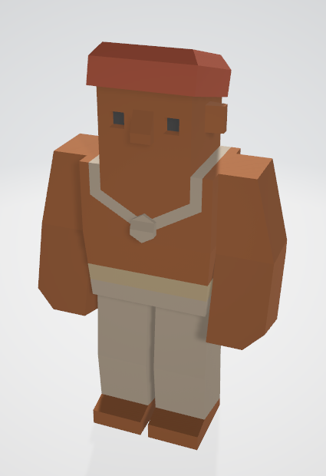
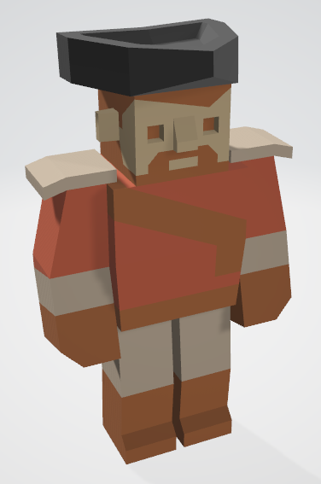
Level 6 – Group 3
Ship Happens
Tom Gibbs
Henry Crofts

Slide 2
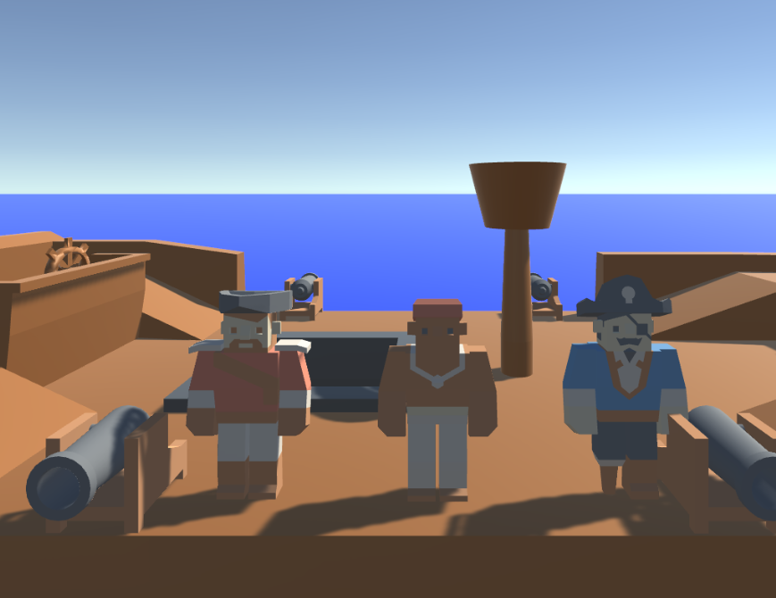
Logline
Local coop resource management game where players must coordinate to resolve hazards and manage activities, figuring out the optimal strategy

Slide 3
Demographic
13 – 24 year old male
Mid-core games
Destruction / Completion
PC / Console / Switch

Slide 4
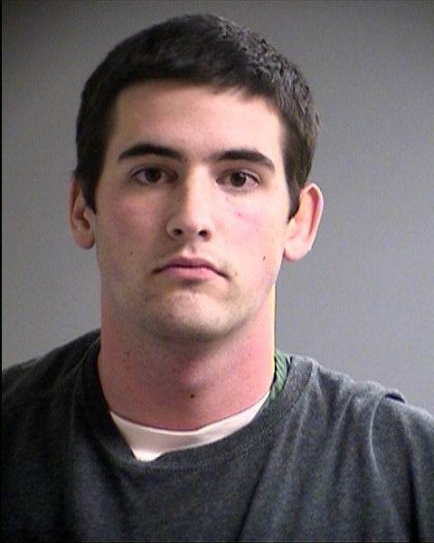
Psychographic
Terry Goldhorn
Aspiring Personal Trainer
Goal oriented / Targets / Progression
Social, plays games and goes out with friends
Student 20 y/o – Sport Sciences
Shared Accommodation
Morning Run / Lectures / Work / Evening Downtime

Slide 5
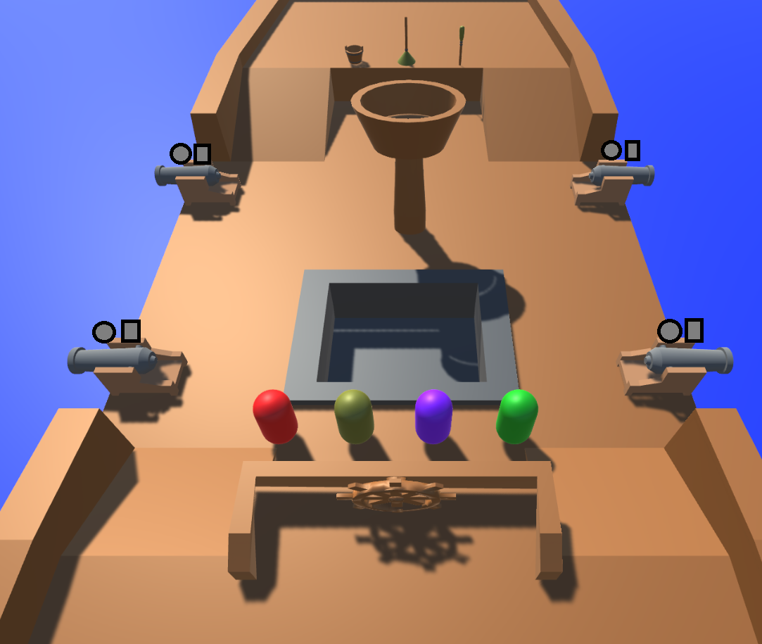
Tutorial: Start Mock-Up

Slide 6
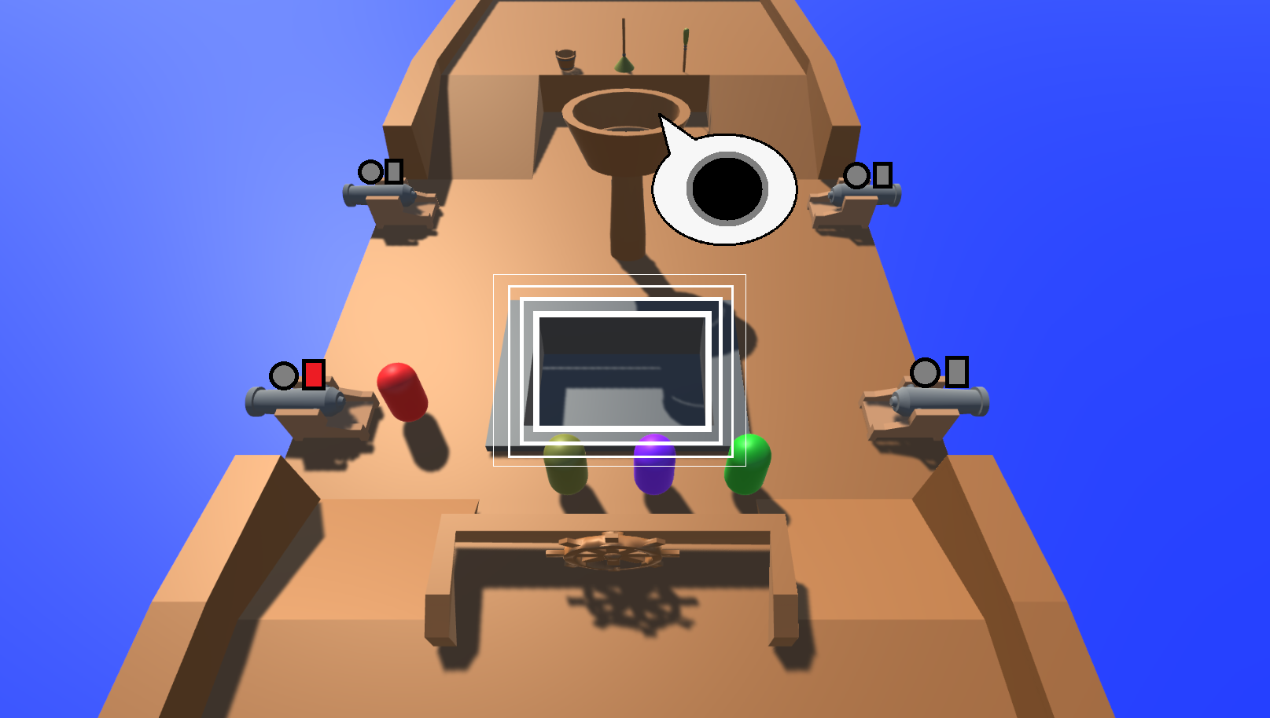
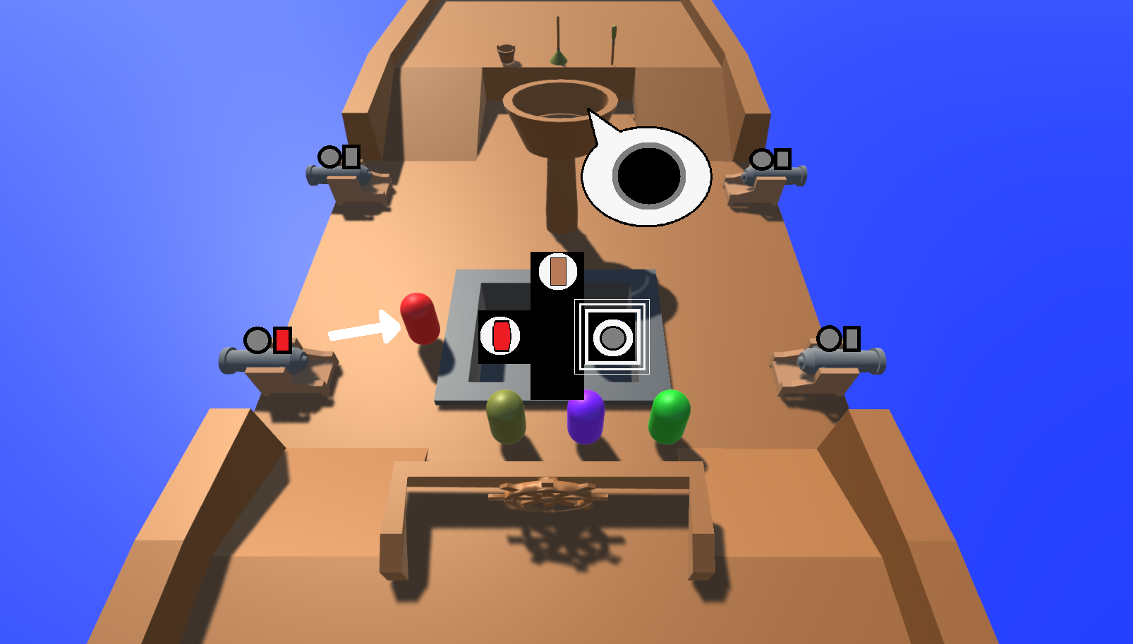
Tutorial: Cannonball & UI

Slide 7
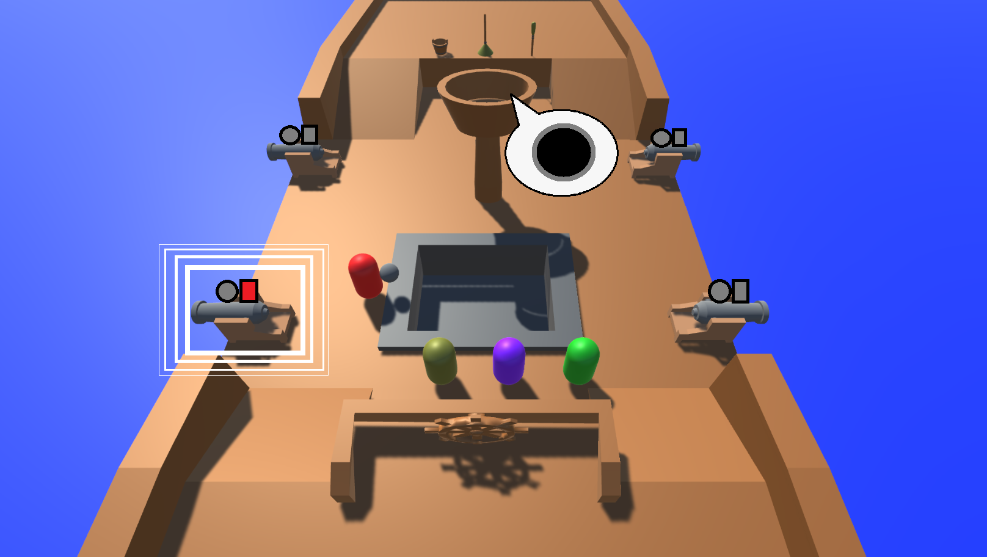
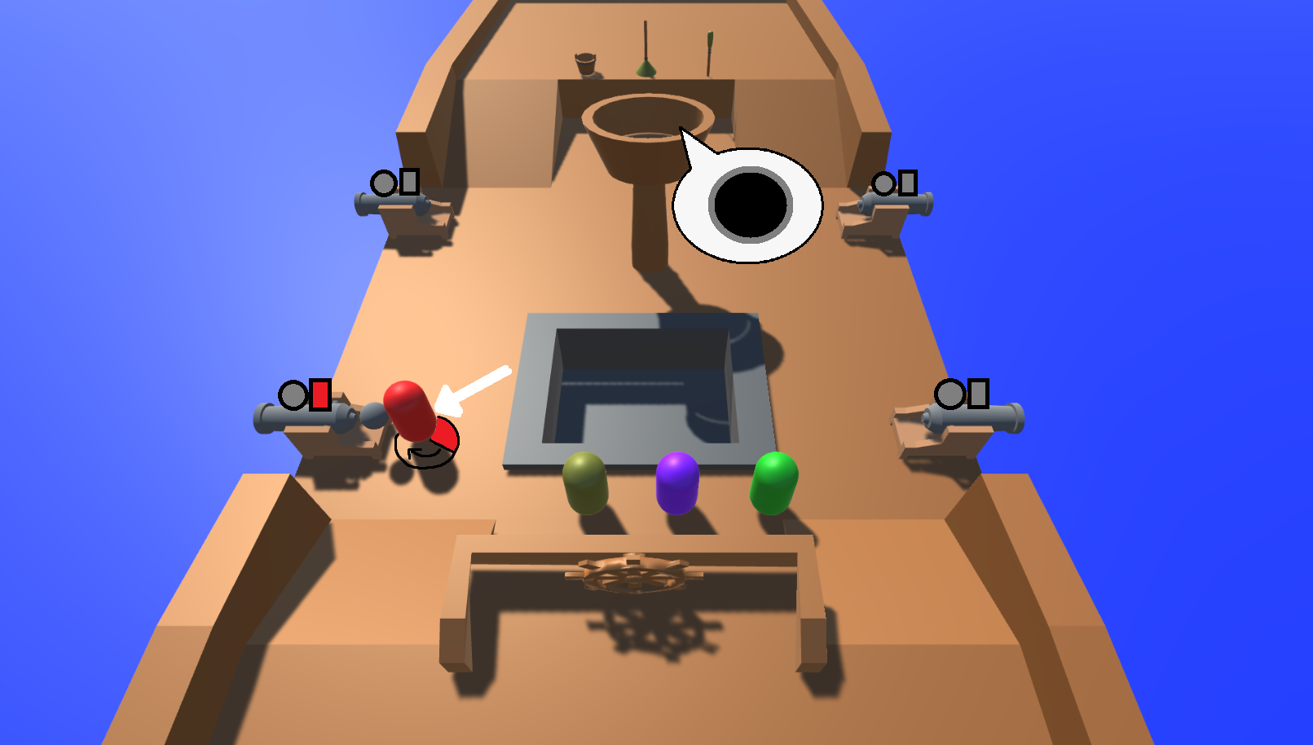
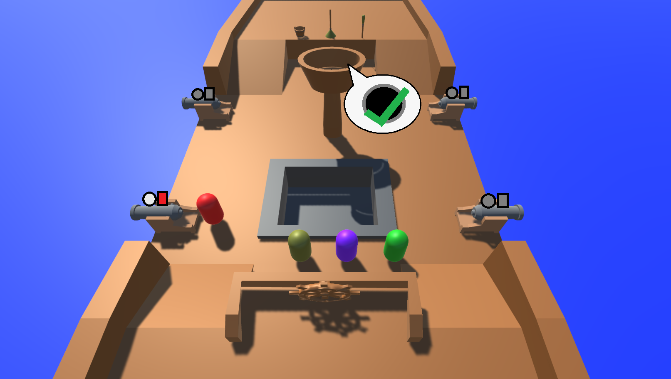
Tutorial: Load Cannonball

Slide 8
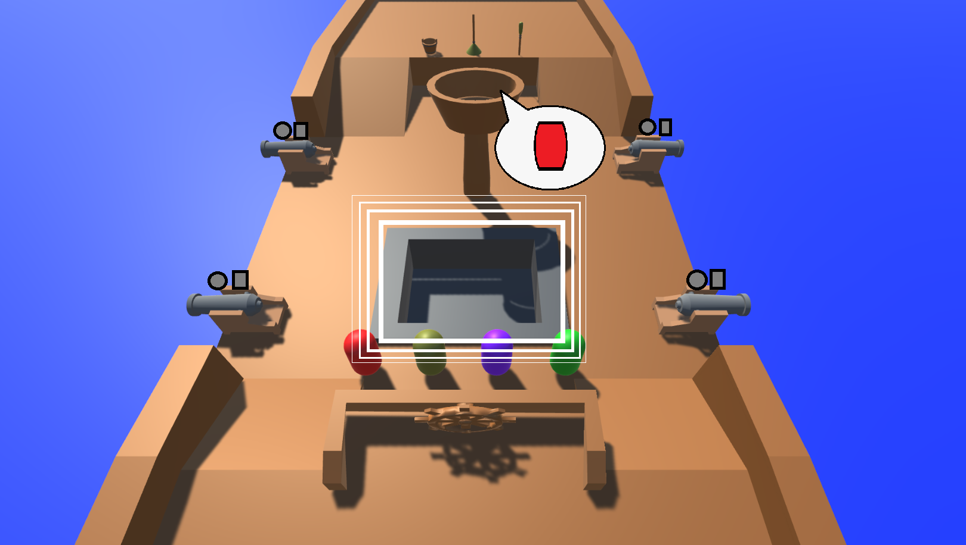
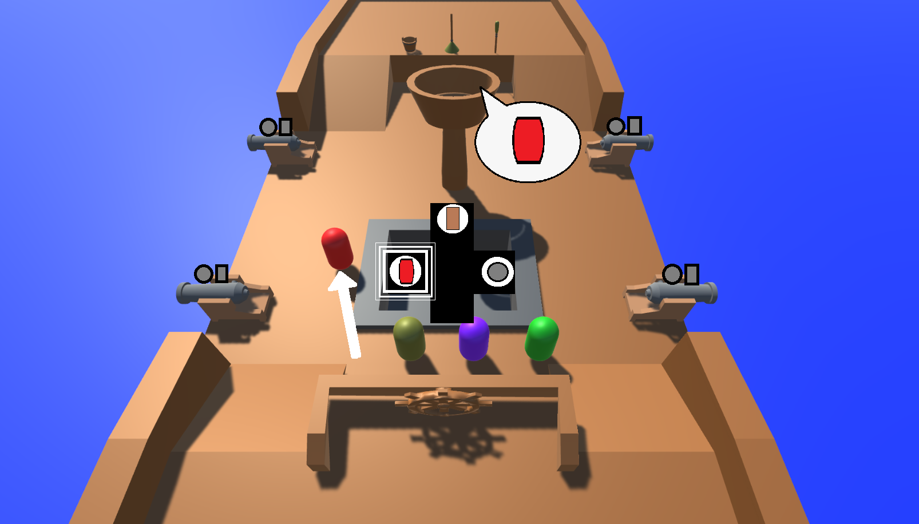
Tutorial: Gunpowder & UI

Slide 9
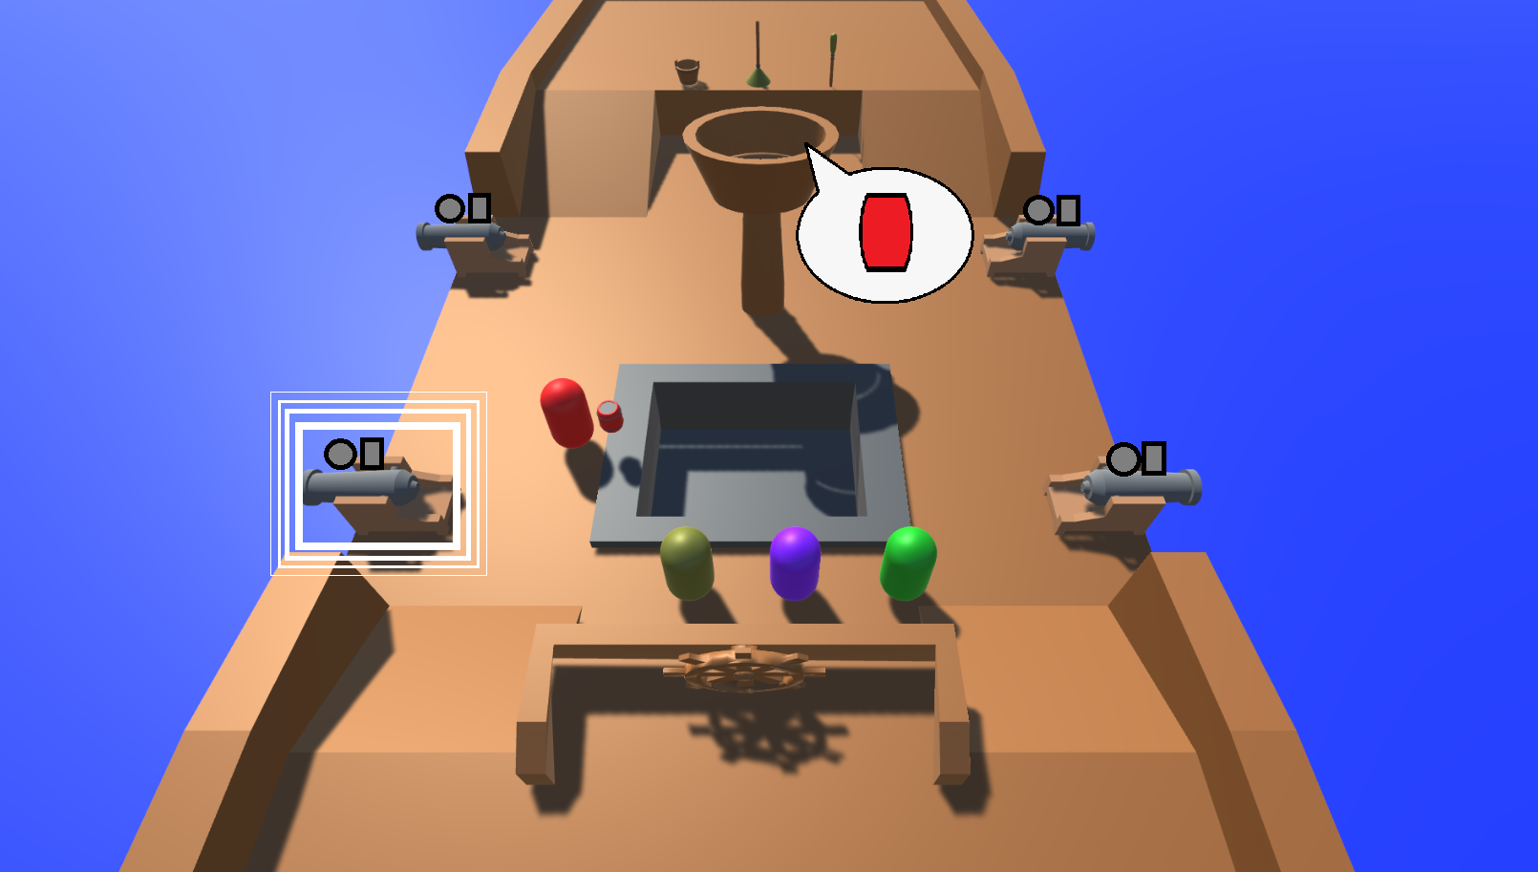
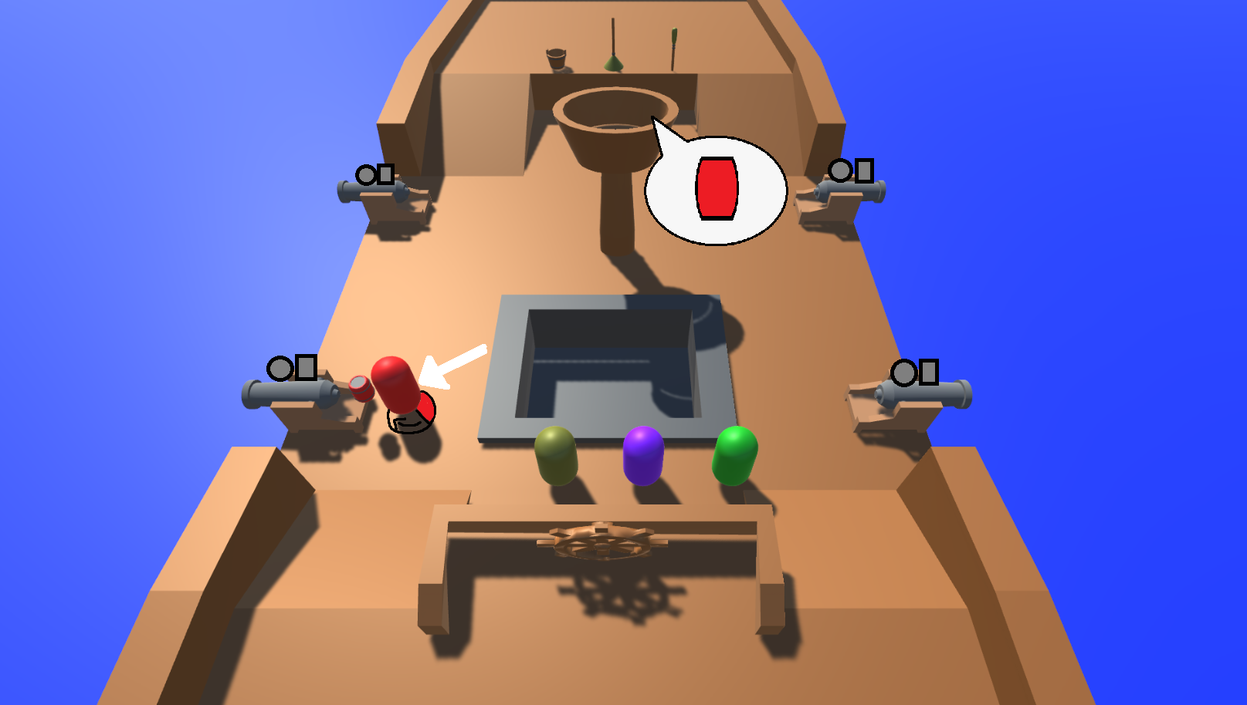
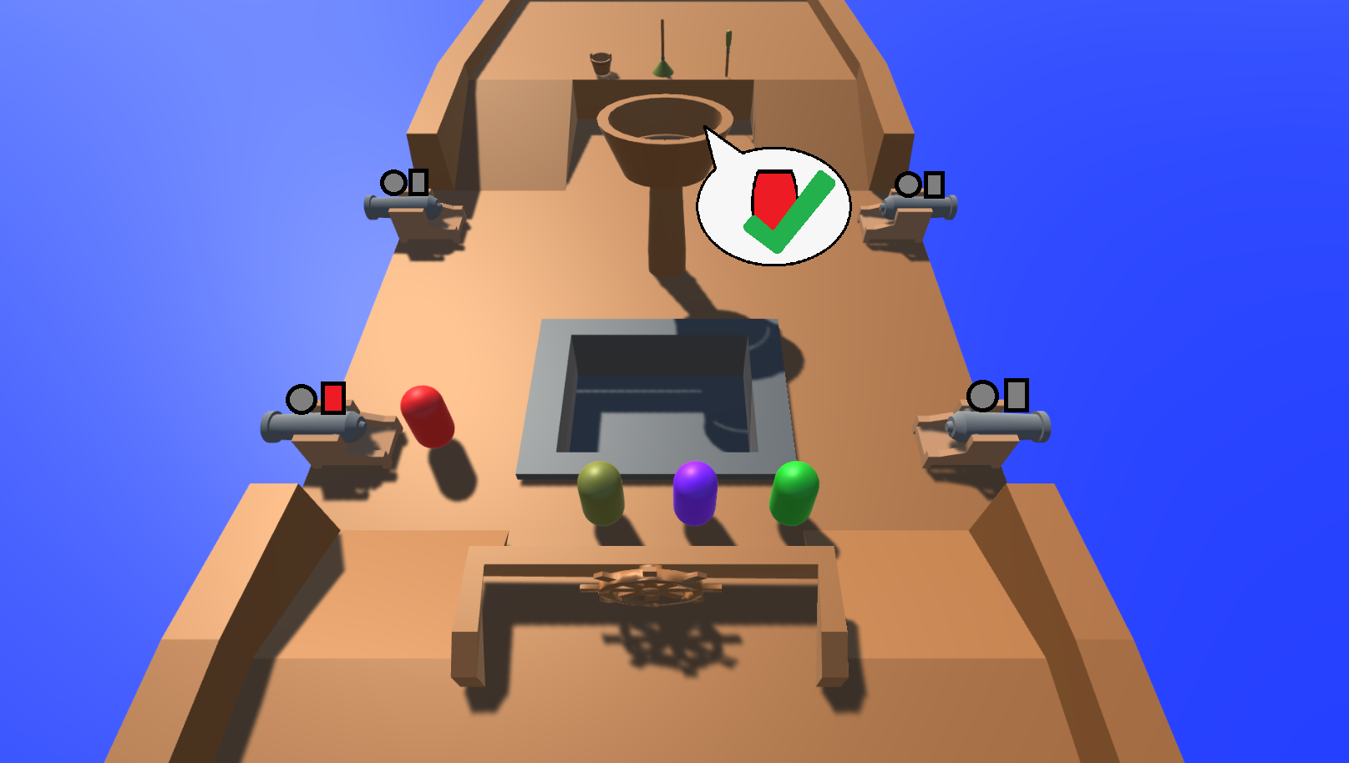
Tutorial: Load Gunpowder

Slide 10
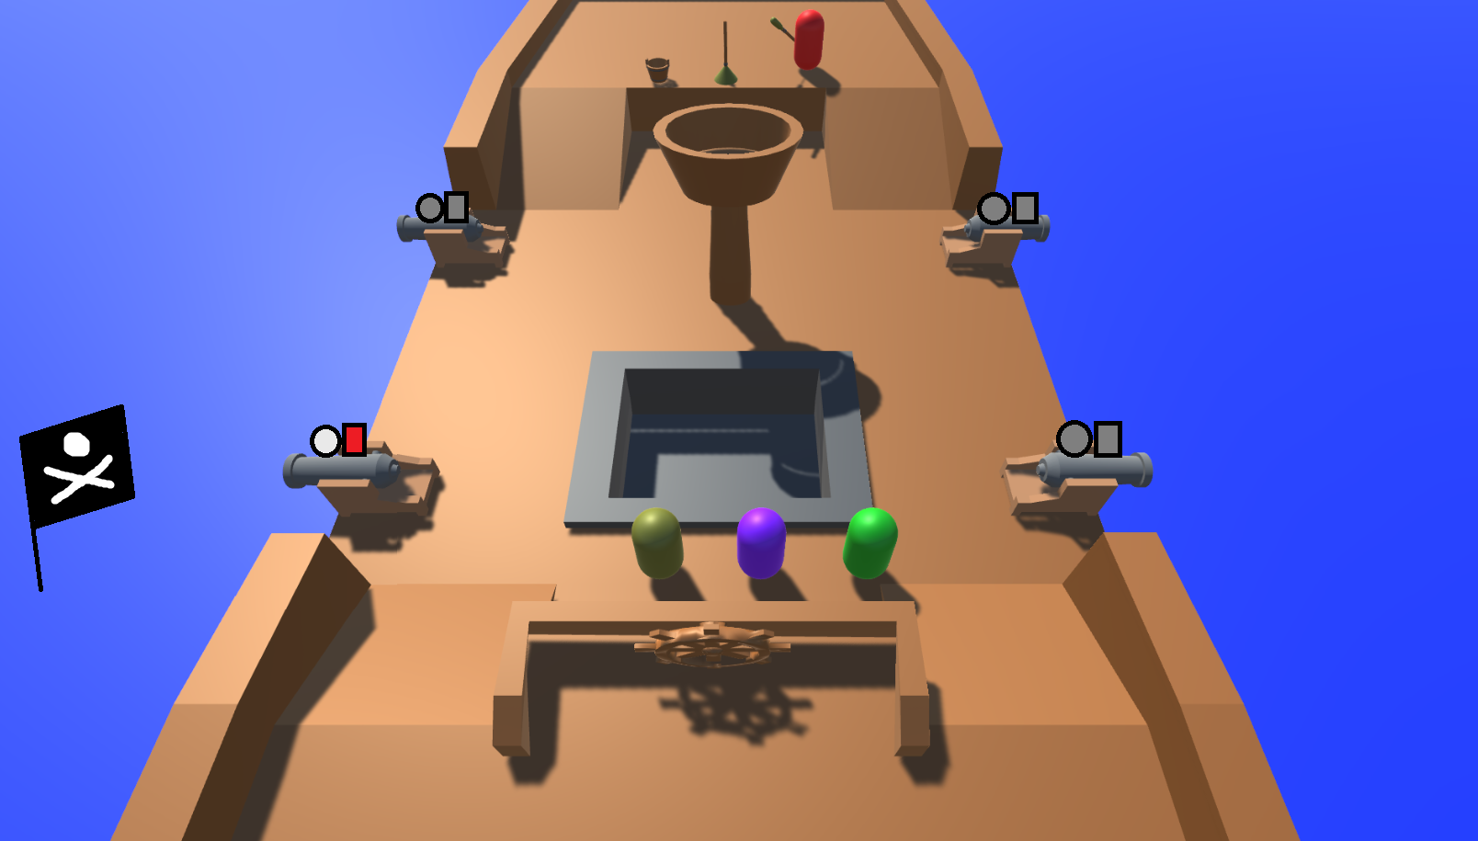
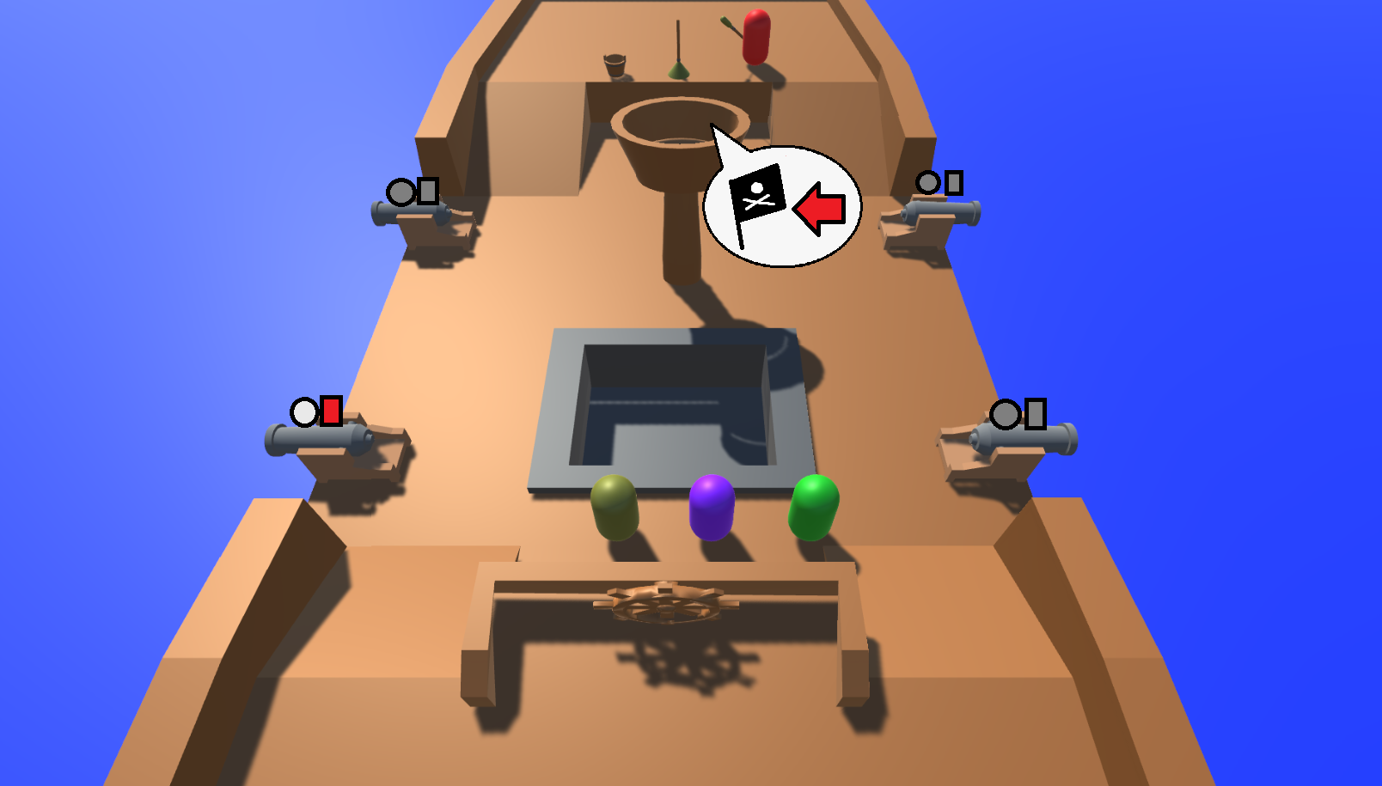
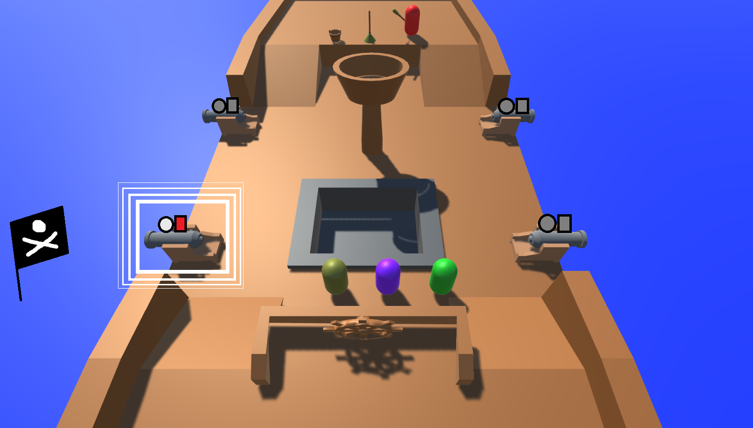
Tutorial: Show Enemy Flag Location

Slide 11
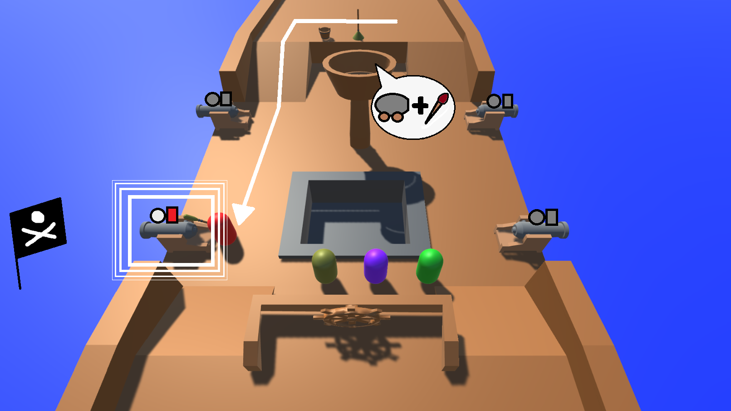
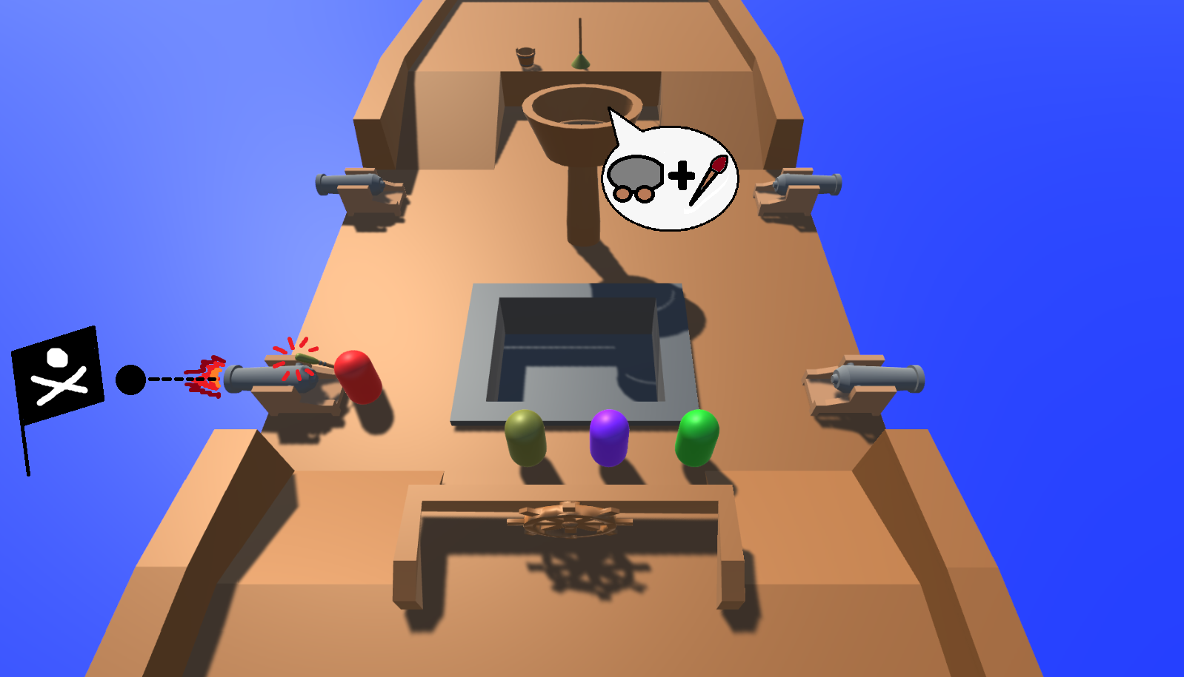
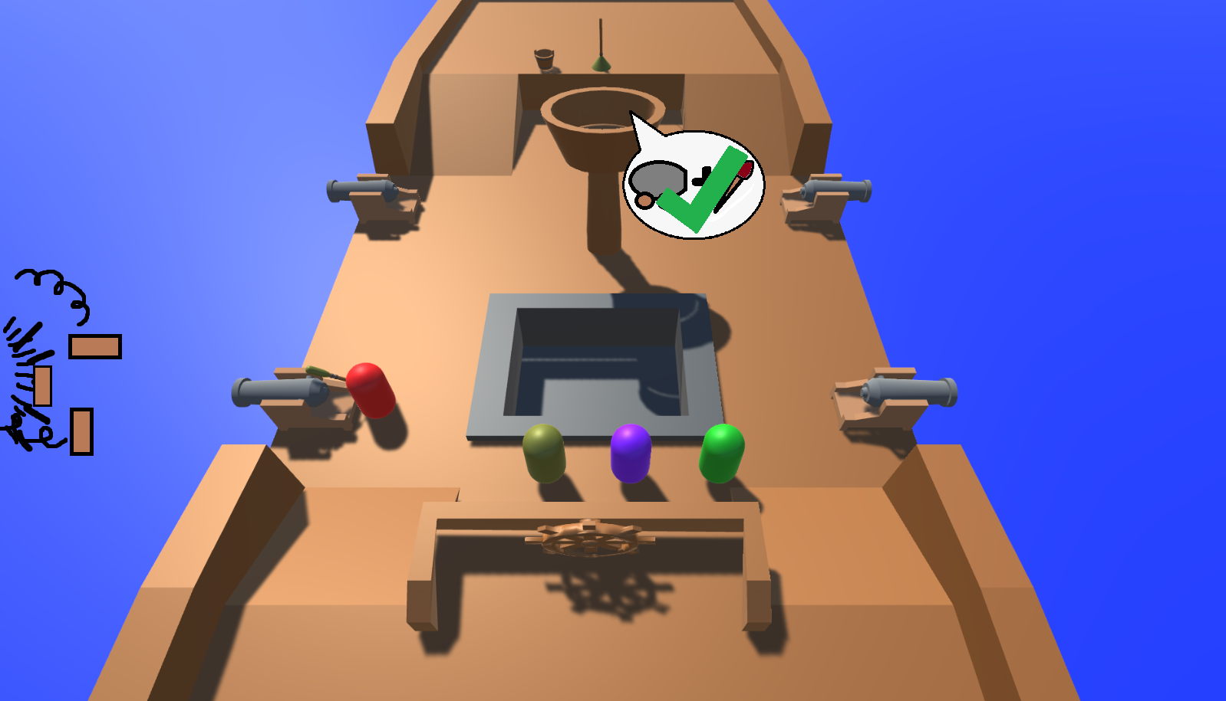
Tutorial: Cannon Firing

Slide 12
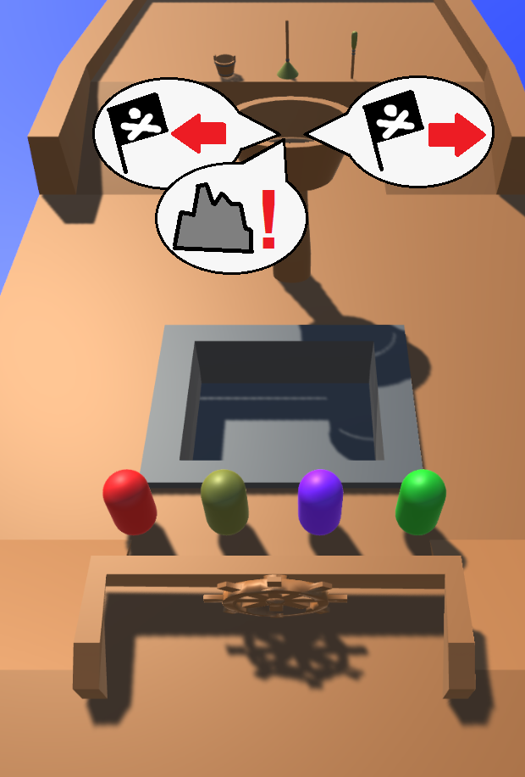
Tutorial: Crow’s Nest Call Outs

Slide 13
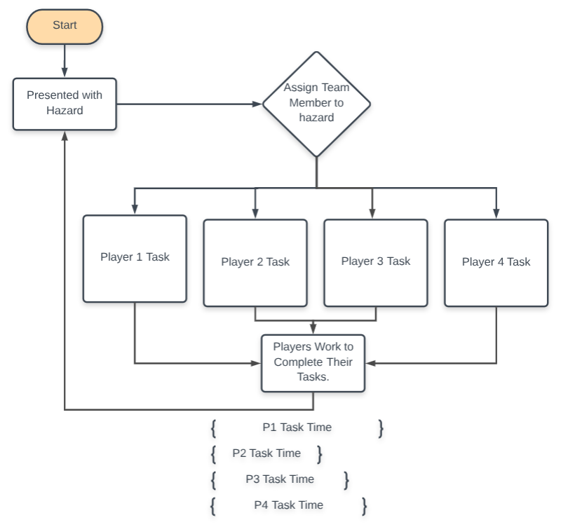
Flow Chart

Slide 14
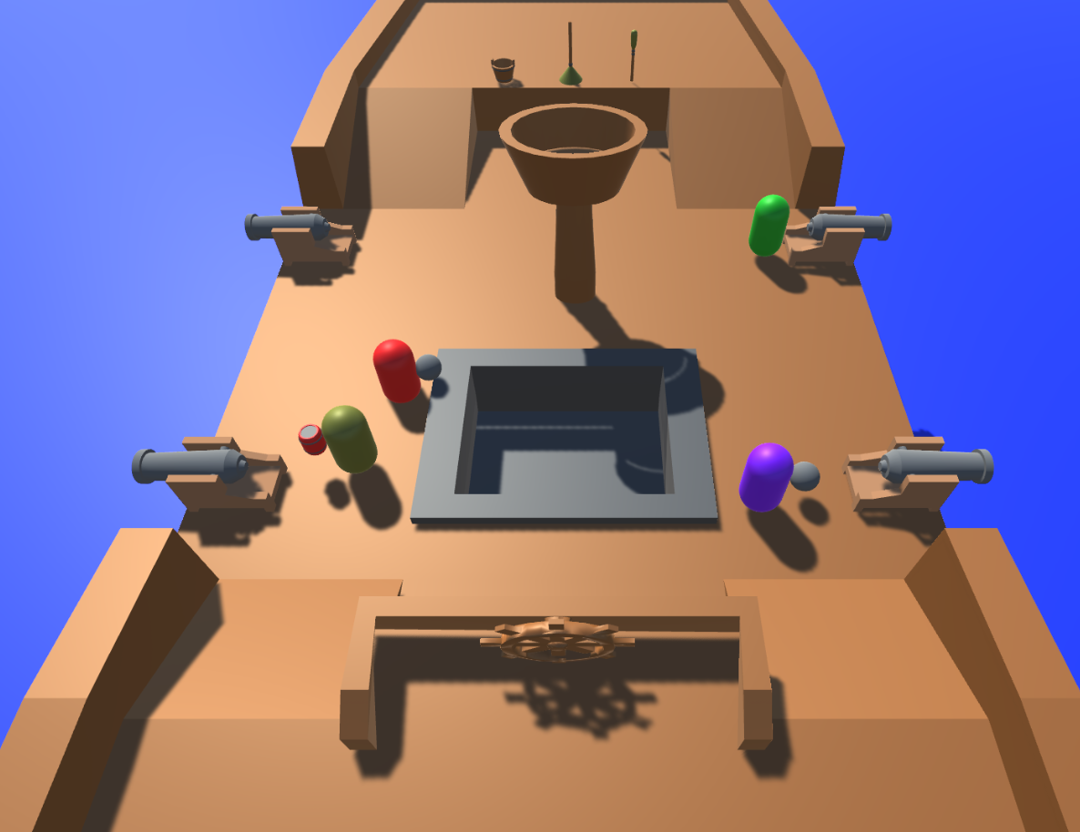
Gameplay: 5 Seconds

Slide 15
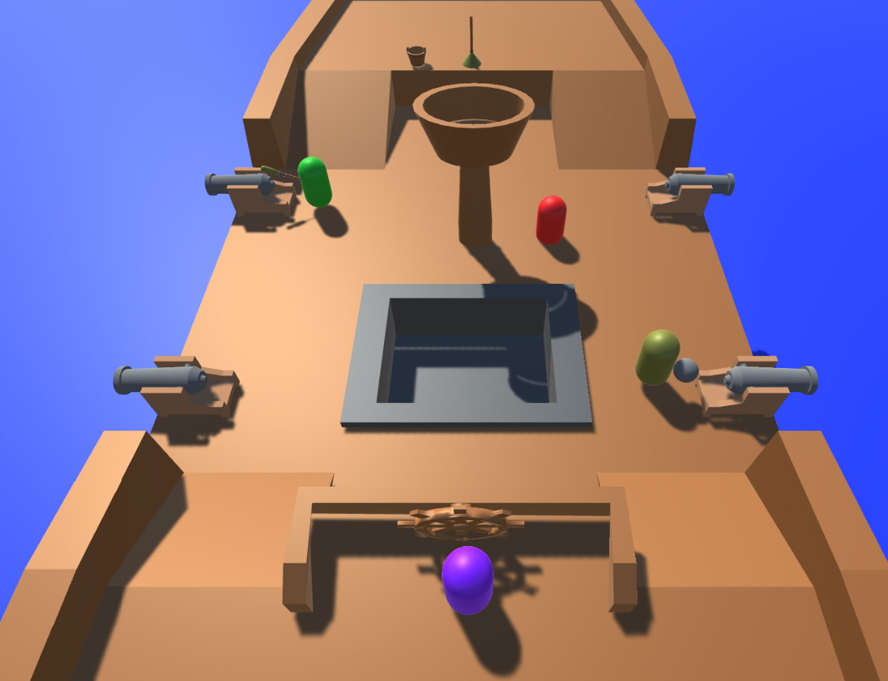
Gameplay: 20 Seconds

Slide 16
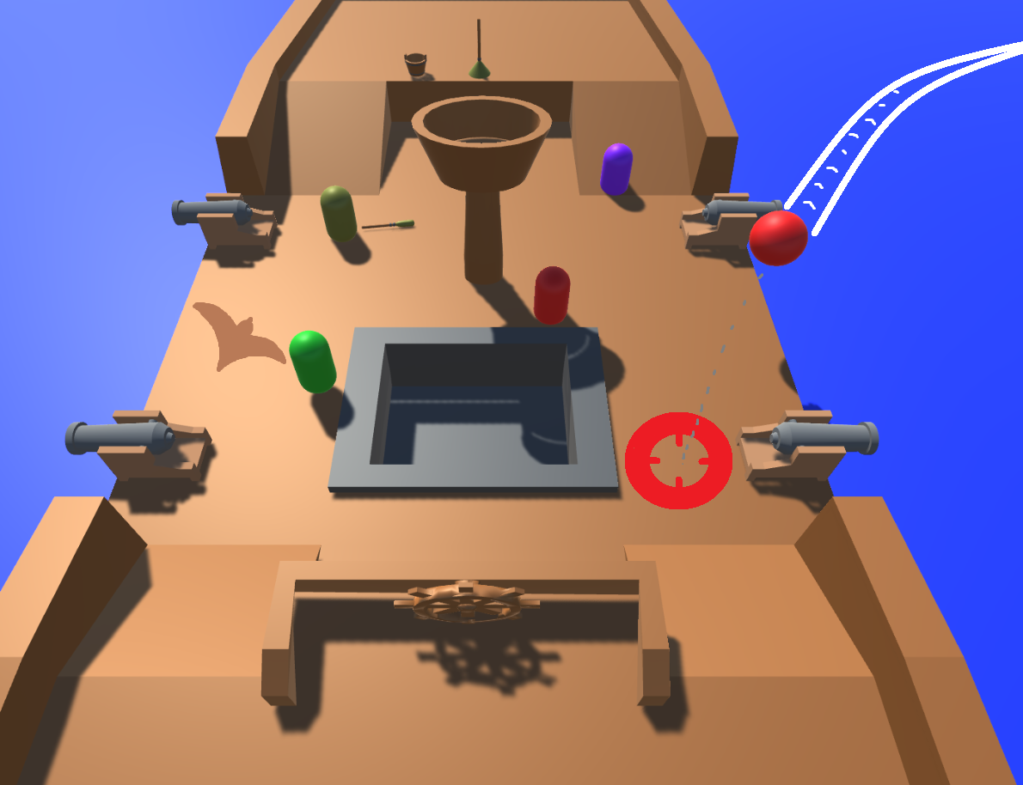
Gameplay: 40 Seconds

Slide 17
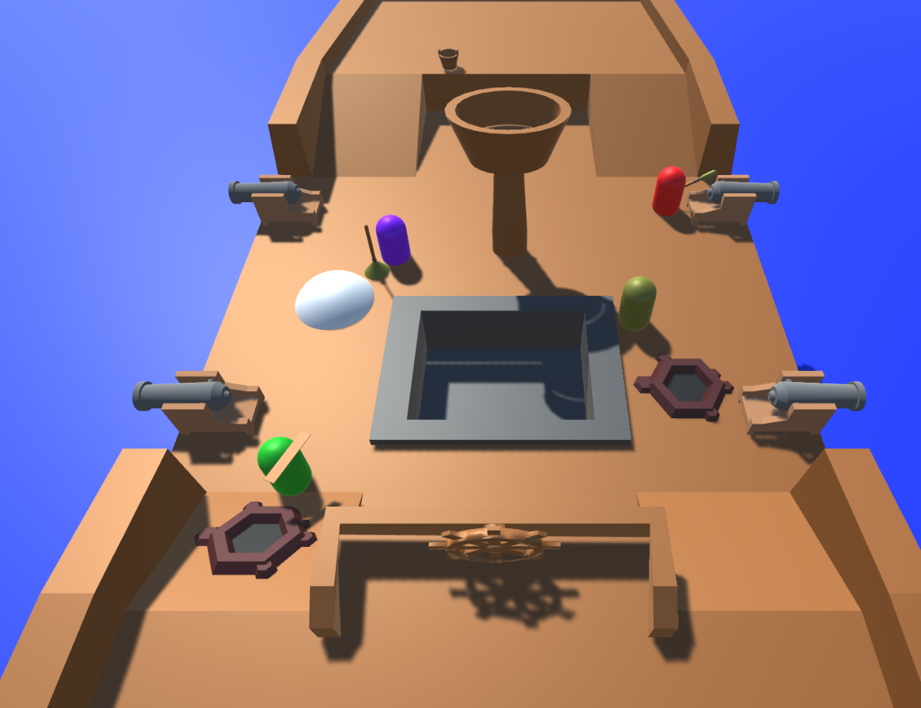
Gameplay: 1 Minute

Slide 18
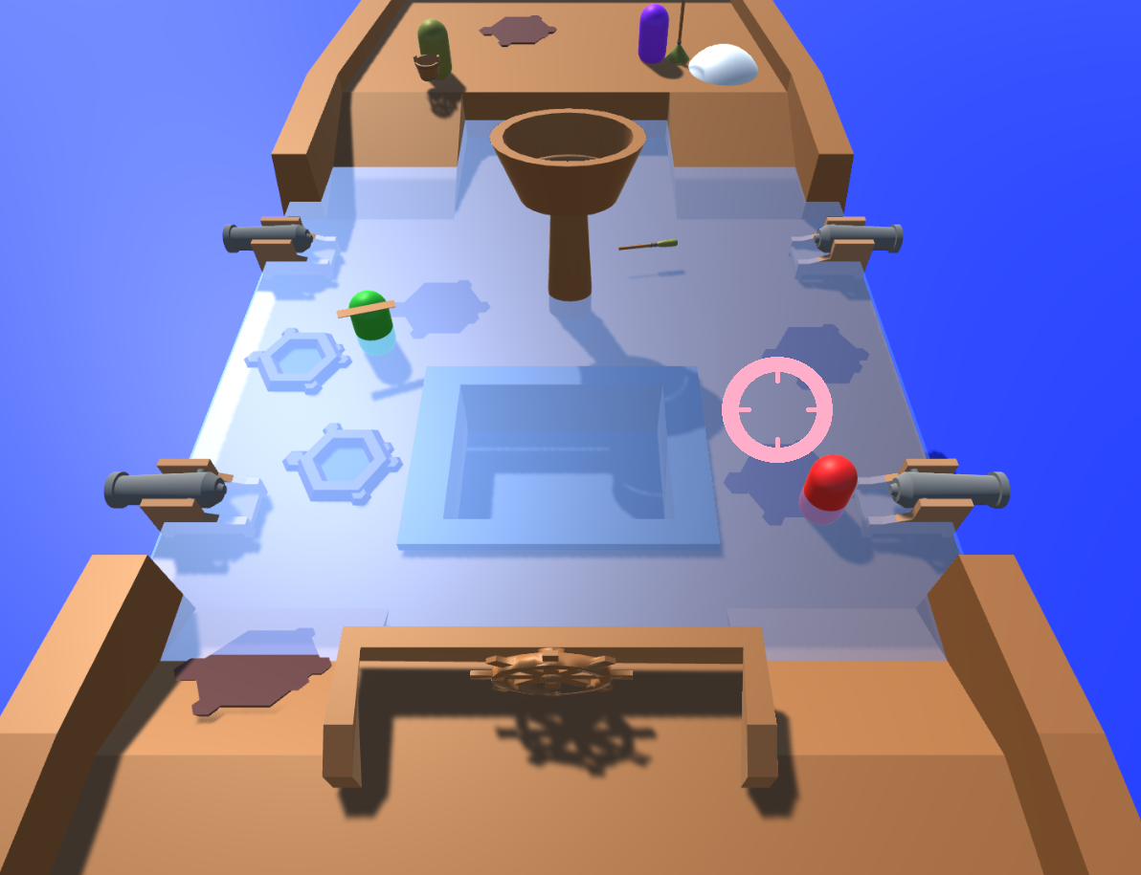
Gameplay: 2 Minutes

Slide 19
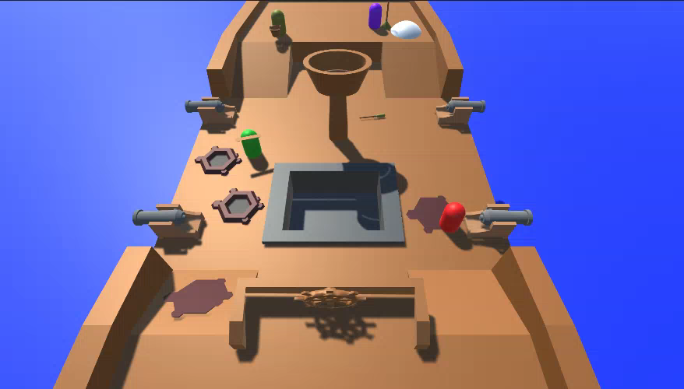
Telegraphing Ship Health

Slide 20
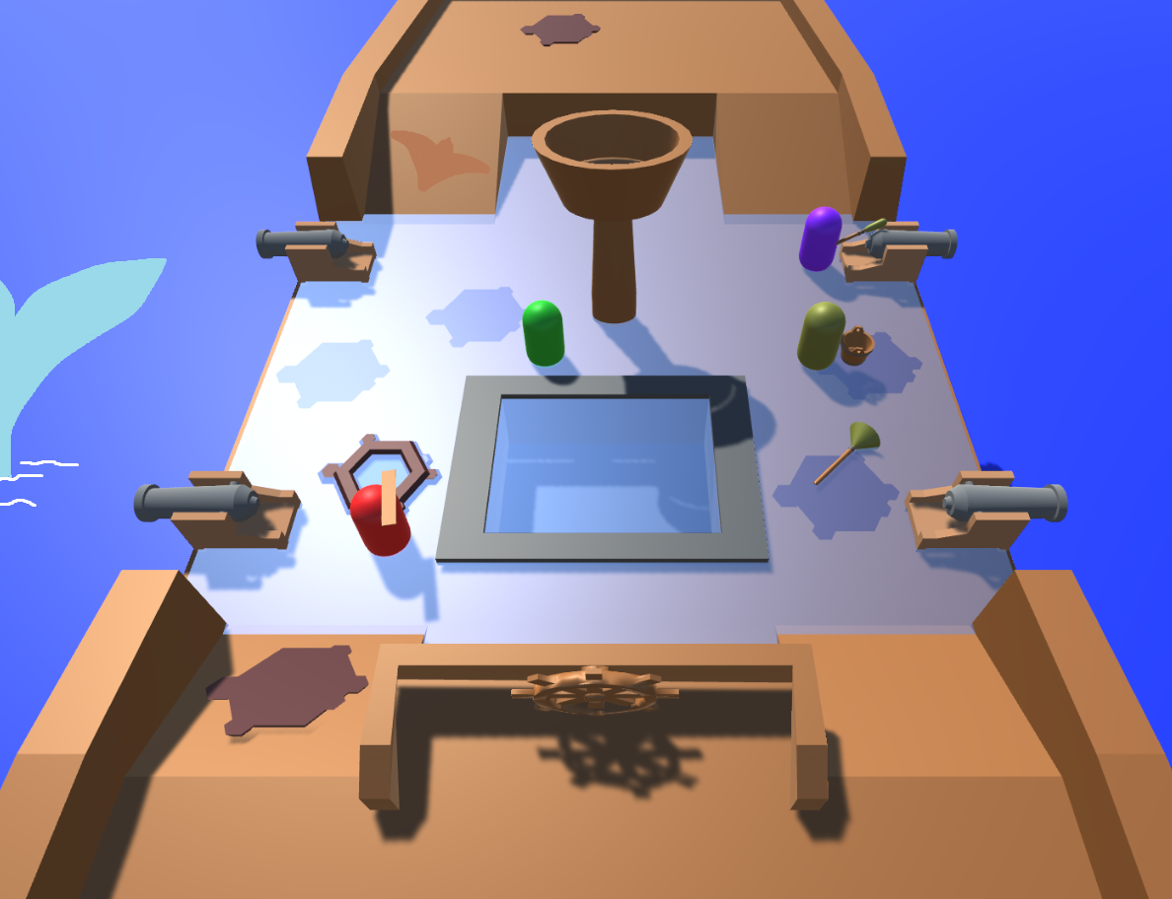
Gameplay: 4 Minutes

Slide 21
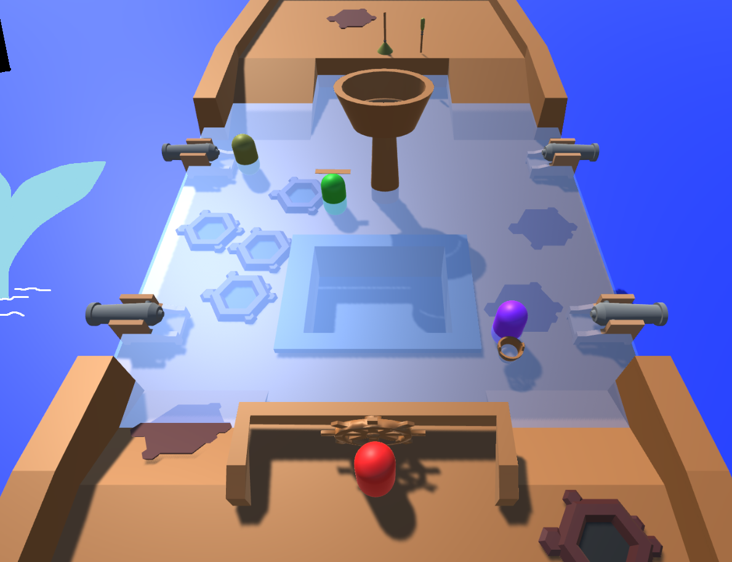
Gameplay: 5 Minutes

Slide 22
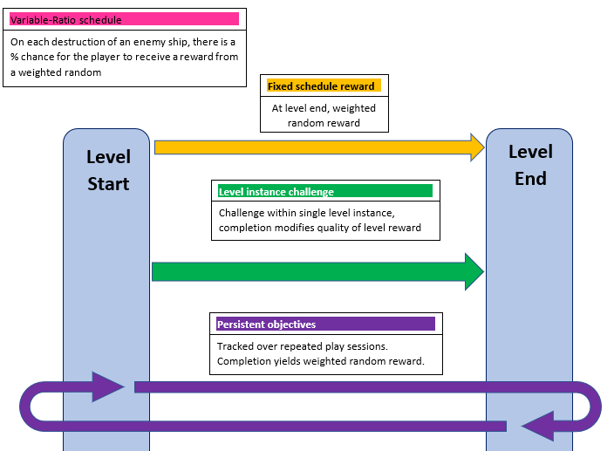
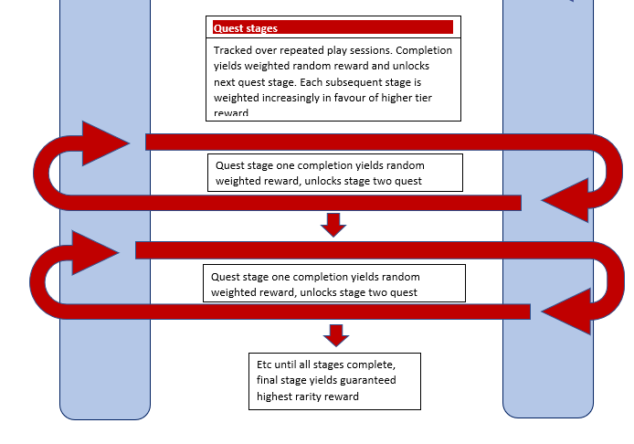
Reward Schedules

Slide 23
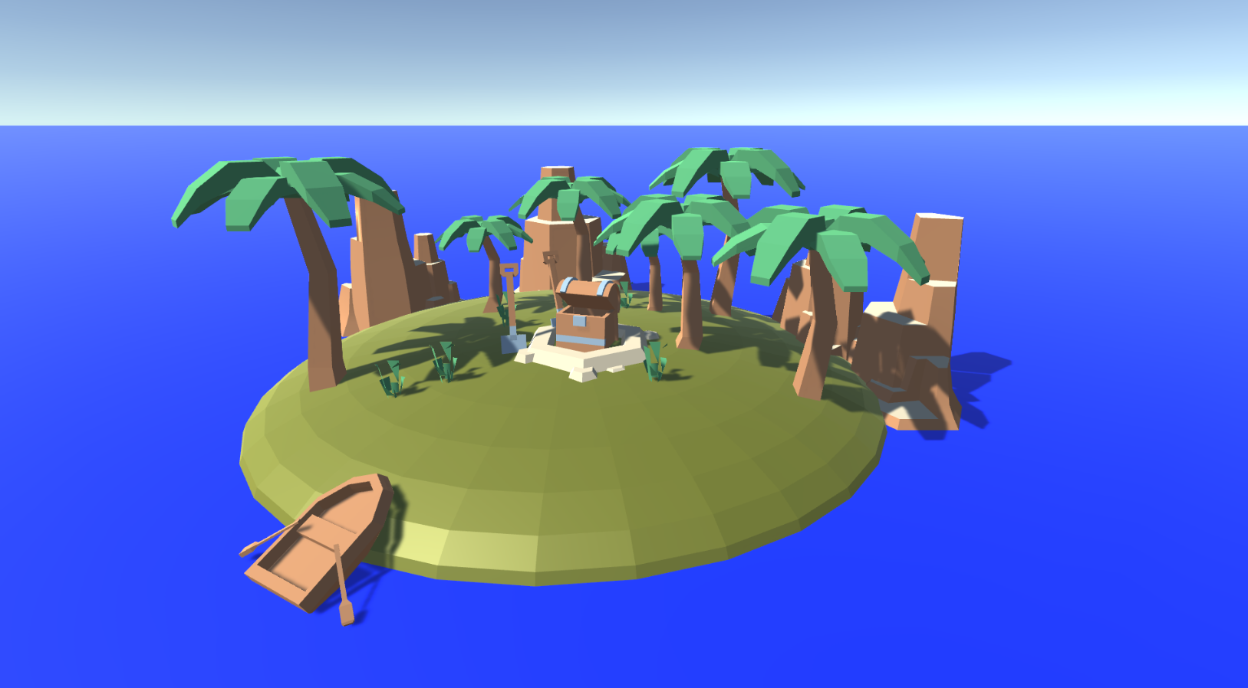
Rewards

Slide 24
Milestones for Minimum Viable Product
Balancing
Code structure, interfaces
Player movement and interaction by
UI
Action logic in objects

Slide 25
Milestones for Minimum Viable Product
Player select and customisation (Placeholder assets)
Rewards
Tutorial paced correctly
Playtesting
Extra mechanics if not hard enough

Slide 26
Questions?

